Slide 1
UNIT-IV
Intents and
Broadcast Receivers

Slide 2
Syllabus
Intents:
Using intents to launch Activities
Types of Intents
Passing data to Intents
Getting results from Activities
Broadcast Receivers:
Using Intent filters to service implicit Intents
Resolving Intent filters

Slide 3
Intents
In Android, users may jump from one application to another as a part of the whole process, for example, searching for a location on the browser and witnessing a direct jump into Google Maps or receiving payment links in Messages Application (SMS) and on clicking jumping to PayPal or GPay (Google Pay).
This process of taking users from one application to another is achieved by passing the Intent to the system.
Intents, in general, are used for navigating among various activities within the same application, but is not limited to one single application, i.e., they can be utilized from moving from one application to another as well.

Slide 4
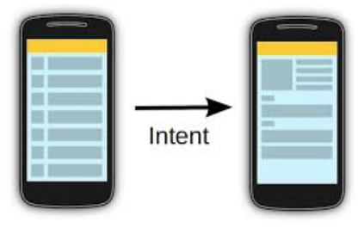
An intent is a messaging object used to request any action from another app component.
Intents facilitate communication between different components in several ways.
The intent is used to launch an activity, start the services, broadcast receivers, display a web page, dial a phone call, send messages from one activity to another activity, and so on.

Slide 5
Below are some applications of Intents:
Sending the User to Another App
Getting a Result from an Activity
Allowing Other Apps to Start Your Activity
Some Important Method of Intent and their Description
Context.startActivity() | This is to launch a new activity or get an existing activity to be action.
Context.startService() | This is to start a new service or deliver instructions for an existing service.
Context.sendBroadcast() | This is to deliver the message to broadcast receivers.

Slide 6
Intent facilitate you to redirect your activity to another activity on occurrence of any event. By calling, startActivity() you can perform this task.
Intent intent = new Intent(getApplicationContext(), SecondActivity.class);
startActivity(intent);
In the above example, foreground activity is getting redirected to another activity i.e. SecondActivity.java. getApplicationContext() returns the context for your foreground activity.

Slide 7
Intent uses
Android uses Intents for facilitating communication between its components like Activities, Services and Broadcast Receivers.
Intent for an Activity:
Every screen in Android application represents an activity. To start a new activity you need to pass an Intent object to startActivity() method. This Intent object helps to start a new activity and passing data to the second activity.
Intent for Services:
Services work in background of an Android application and it does not require any user Interface. Intents could be used to start a Service that performs one-time task(for example: Downloading some file) or for starting a Service you need to pass Intent to startService() method.
Intent for Broadcast Receivers:
There are various message that an app receives, these messages are called as Broadcast Receivers. (For example, a broadcast message could be initiated to intimate that the file downloading is completed and ready to use). Android system initiates some broadcast message on several events, such as System Reboot, Low Battery warning message etc.

Slide 8
Types of Android Intents
Implicit
Explicit
1. Implicit Intent
It doesn’t specify the component. For example, you may write the following code to view the webpage.
Syntax:
Intent intent=new Intent(Intent.ACTION_VIEW);
intent.setData(Uri.parse("https://www.google.com"));
startActivity(intent);
Example:
In the above, no component is specified, instead, an action is performed i.e. a webpage is going to be opened. As you type the name of your desired webpage and click on the ‘CLICK’ button. Your webpage is opened.

Slide 9
2. Explicit Intent
Explicit Intent specifies the component. In such a case, intent provides the external class to be invoked.
Syntax:
Intent i = new Intent(getApplicationContext(), SecondActivity.class);
startActivity(i);
Example:
In the above example, there are two activities (MaintActivity, and SecondActivity). When you click on the ‘Go to Second Activity’ Button in the MainActivity, then you move to the SecondActivity. When you click on the ‘GO TO HOME ACTIVITY’ button in the SecondActivity, then you move to the MainActivity. This is getting done through Explicit Intent.

Slide 10
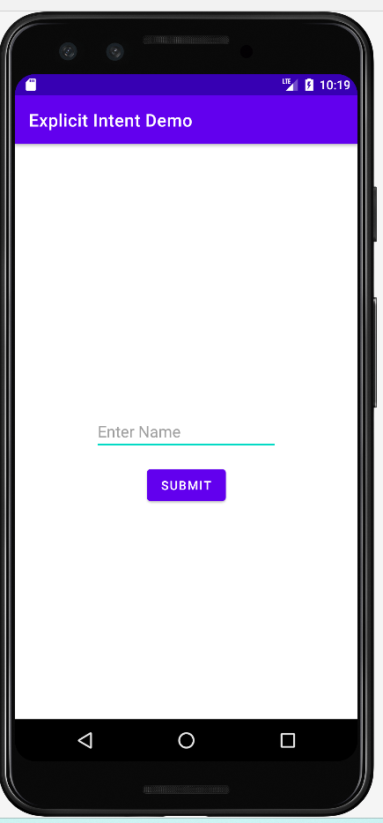
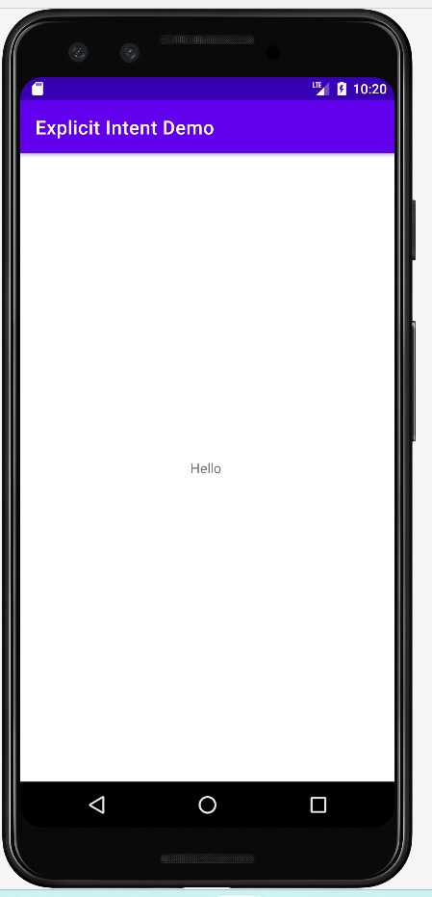
Explicit Intent Demo
MainActivity
SecondActivity

Slide 11
<?xml version="1.0" encoding="utf-8"?> <androidx.constraintlayout.widget.ConstraintLayout xmlns:android="http://schemas.android.com/apk/res/android" xmlns:app="http://schemas.android.com/apk/res-auto" xmlns:tools="http://schemas.android.com/tools" android:layout_width="match_parent" android:layout_height="match_parent" tools:context=".MainActivity"> <EditText android:id="@+id/editTextName" android:layout_width="wrap_content" android:layout_height="wrap_content" android:ems="10" android:hint="Enter Name" android:inputType="text" app:layout_constraintBottom_toBottomOf="parent" app:layout_constraintEnd_toEndOf="parent" app:layout_constraintStart_toStartOf="parent" app:layout_constraintTop_toTopOf="parent" /> <Button android:id="@+id/btnSubmit" android:layout_width="wrap_content" android:layout_height="wrap_content" android:onClick="SayHello" android:text="Submit" app:layout_constraintBottom_toBottomOf="parent" app:layout_constraintEnd_toEndOf="parent" app:layout_constraintStart_toStartOf="parent" app:layout_constraintTop_toTopOf="parent" app:layout_constraintVertical_bias="0.60" /> </androidx.constraintlayout.widget.ConstraintLayout>

Slide 12
<?xml version="1.0" encoding="utf-8"?> <androidx.constraintlayout.widget.ConstraintLayout xmlns:android="http://schemas.android.com/apk/res/android" xmlns:app="http://schemas.android.com/apk/res-auto" xmlns:tools="http://schemas.android.com/tools" android:layout_width="match_parent" android:layout_height="match_parent" tools:context=".SecondActivity"> <TextView android:id="@+id/textReceived" android:layout_width="wrap_content" android:layout_height="wrap_content" android:text="TextView" app:layout_constraintBottom_toBottomOf="parent" app:layout_constraintEnd_toEndOf="parent" app:layout_constraintStart_toStartOf="parent" app:layout_constraintTop_toTopOf="parent" /> </androidx.constraintlayout.widget.ConstraintLayout>

Slide 13
package com.example.demo2; import androidx.appcompat.app.AppCompatActivity; import android.content.Intent; import android.os.Bundle; import android.view.View; import android.widget.EditText; public class MainActivity extends AppCompatActivity { @Override protected void onCreate(Bundle savedInstanceState) { super.onCreate(savedInstanceState); setContentView(R.layout.activity_main); } public void SayHello(View view){ EditText editTextName; editTextName = findViewById(R.id.editTextName); String name = editTextName.getText().toString(); Intent intent = new Intent(MainActivity.this, SecondActivity.class); intent.putExtra("name",name); startActivity(intent); } }

Slide 14
package com.example.demo2; import androidx.appcompat.app.AppCompatActivity; import android.os.Bundle; import android.widget.TextView; public class SecondActivity extends AppCompatActivity { @Override protected void onCreate(Bundle savedInstanceState) { super.onCreate(savedInstanceState); setContentView(R.layout.activity_second); String name = getIntent().getExtras().getString("name"); TextView textReceived = findViewById(R.id.textReceived); textReceived.setText(name); } }

Slide 15
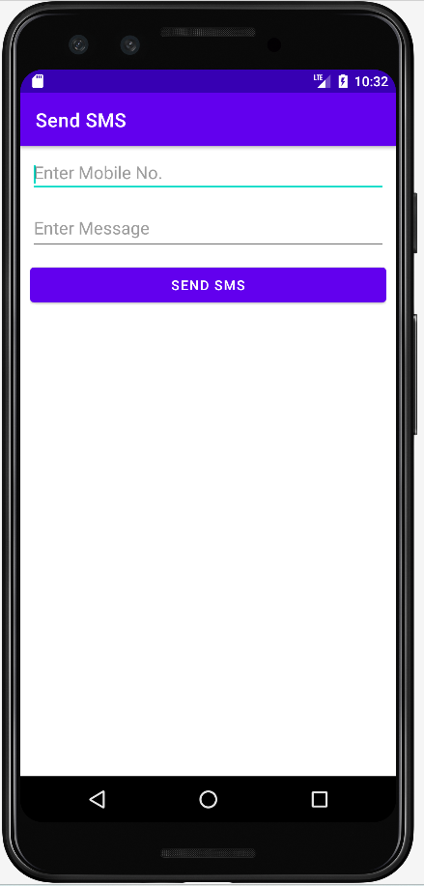
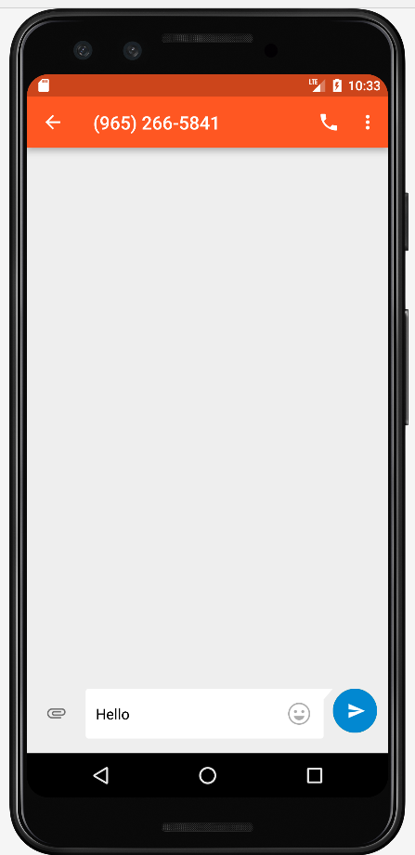
Implicit Intent Demo
MainActivity
Native Send SMS App

Slide 16
<?xml version="1.0" encoding="utf-8"?> <LinearLayout xmlns:android="http://schemas.android.com/apk/res/android" xmlns:app="http://schemas.android.com/apk/res-auto" xmlns:tools="http://schemas.android.com/tools" android:layout_width="match_parent" android:layout_height="match_parent" android:orientation="vertical" android:layout_margin="10dp" tools:context=".MainActivity"> <EditText android:id="@+id/textMobileNo" android:hint="Enter Mobile No." android:layout_width="match_parent" android:inputType="phone" android:layout_height="40dp"></EditText> <EditText android:id="@+id/textMessage" android:hint="Enter Message" android:layout_width="match_parent" android:inputType="textMultiLine" android:layout_marginTop="10dp" android:layout_height="50dp"></EditText> <Button android:layout_width="match_parent" android:layout_height="wrap_content" android:onClick="SendSMS" android:text="SEND SMS" android:layout_marginTop="10dp" ></Button> </LinearLayout>

Slide 17
package com.example.sendsmsdemo; import androidx.appcompat.app.AppCompatActivity; import android.content.Intent; import android.net.Uri; import android.os.Bundle; import android.view.View; import android.widget.EditText; public class MainActivity extends AppCompatActivity { @Override protected void onCreate(Bundle savedInstanceState) { super.onCreate(savedInstanceState); setContentView(R.layout.activity_main); } public void SendSMS(View view){ EditText textMobileNo = findViewById(R.id.textMobileNo); EditText textMessage = findViewById(R.id.textMessage); String mobileNo = textMobileNo.getText().toString(); String message = textMessage.getText().toString(); Intent intent=new Intent(Intent.ACTION_VIEW, Uri.fromParts("sms",mobileNo,null)); intent.putExtra("sms_body",message); startActivity(intent); } }

Slide 18
Pass Data from One Activity to Another in Android
We can send data while calling one activity from another activity using intent. All we have to do is add the data to Intent object using putExtra() method. The data is passed in key value pair. The value can be of types like int, float, long, string, etc.
Sending Data:
Intent intent = new Intent(context,DestinationActivityName.class);
intent.putExtra(Key, Value);
startActivity(intent);
Retrieving Data:
Intent intent = getIntent();
String name = getIntent().getExtras().getString("name");

Slide 19
Getting Results from Intents
You can also start another activity and receive a result back.
To receive a result, call startActivityForResult() (instead of startActivity()).
For example, your app can start a camera app and receive the captured photo as a result. Or, you might start the People app in order for the user to select a contact and you'll receive the contact details as a result.
The activity that responds must be designed to return a result. When it does, it sends the result as another Intent object. Your activity receives it in the onActivityResult() callback.

Slide 20
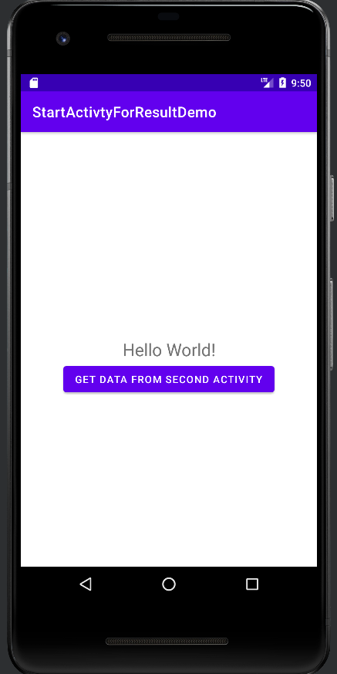
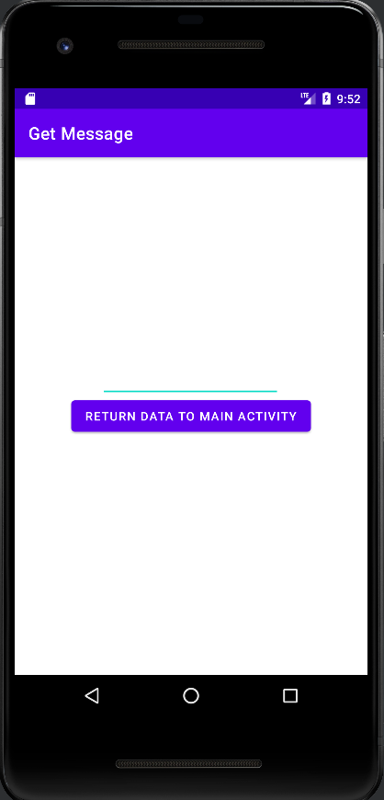
Example:

Slide 21
Activity_main.xml:
<?xml version="1.0" encoding="utf-8"?> <androidx.constraintlayout.widget.ConstraintLayout xmlns:android="http://schemas.android.com/apk/res/android" xmlns:app="http://schemas.android.com/apk/res-auto" xmlns:tools="http://schemas.android.com/tools" android:layout_width="match_parent" android:layout_height="match_parent" tools:context=".MainActivity"> <TextView android:id="@+id/textMessage" android:layout_width="wrap_content" android:layout_height="wrap_content" android:text="Hello World!" android:textSize="24dp" app:layout_constraintBottom_toBottomOf="parent" app:layout_constraintEnd_toEndOf="parent" app:layout_constraintStart_toStartOf="parent" app:layout_constraintTop_toTopOf="parent" />

Slide 22
<Button android:id="@+id/btnSubmit" android:layout_width="wrap_content" android:layout_height="wrap_content" android:layout_centerHorizontal="true" android:text="Get Data from Second Activity" android:onClick="GetMessage" app:layout_constraintBottom_toBottomOf="parent" app:layout_constraintEnd_toEndOf="parent" app:layout_constraintStart_toStartOf="parent" app:layout_constraintTop_toTopOf="parent" app:layout_constraintVertical_bias="0.575" /> </androidx.constraintlayout.widget.ConstraintLayout>

Slide 23
activity_second.xml:
<?xml version="1.0" encoding="utf-8"?> <androidx.constraintlayout.widget.ConstraintLayout xmlns:android="http://schemas.android.com/apk/res/android" xmlns:app="http://schemas.android.com/apk/res-auto" xmlns:tools="http://schemas.android.com/tools" android:layout_width="match_parent" android:layout_height="match_parent" tools:context=".SecondActivity"> <EditText android:id="@+id/editMessage" android:layout_width="wrap_content" android:layout_height="wrap_content" android:layout_alignParentTop="true" android:ems="10" app:layout_constraintBottom_toBottomOf="parent" app:layout_constraintEnd_toEndOf="parent" app:layout_constraintHorizontal_bias="0.497" app:layout_constraintStart_toStartOf="parent" app:layout_constraintTop_toTopOf="parent" app:layout_constraintVertical_bias="0.422" />

Slide 24
<Button android:id="@+id/btnSubmit" android:layout_width="wrap_content" android:layout_height="wrap_content" android:layout_centerHorizontal="true" android:text="Return Data to Main Activity" android:onClick="SendMessage" app:layout_constraintBottom_toBottomOf="parent" app:layout_constraintEnd_toEndOf="parent" app:layout_constraintStart_toStartOf="parent" app:layout_constraintTop_toTopOf="parent" /> </androidx.constraintlayout.widget.ConstraintLayout>

Slide 25
Mainactivity.java:
package com.example.startactivtyforresultdemo; import androidx.appcompat.app.AppCompatActivity; import android.content.Intent; import android.os.Bundle; import android.view.View; import android.widget.TextView; public class MainActivity extends AppCompatActivity { TextView textMessage; @Override protected void onCreate(Bundle savedInstanceState) { super.onCreate(savedInstanceState); setContentView(R.layout.activity_main); textMessage=(TextView)findViewById(R.id.textMessage); }

Slide 26
public void GetMessage(View view){ Intent intent=new Intent(MainActivity.this,SecondActivity.class); startActivityForResult(intent, 1);// Activity is started with requestCode 1 } // Call Back method to get the Message form other Activity @Override protected void onActivityResult(int requestCode, int resultCode, Intent data) { super.onActivityResult(requestCode, resultCode, data); // check if the request code is same as what is passed here it is 1 if(requestCode==1) { String message=data.getStringExtra("MESSAGE"); textMessage.setText(message); } } }

Slide 27
Secondactivity.java:
package com.example.startactivtyforresultdemo; import androidx.appcompat.app.AppCompatActivity; import android.content.Intent; import android.os.Bundle; import android.view.View; import android.widget.EditText; public class SecondActivity extends AppCompatActivity { @Override protected void onCreate(Bundle savedInstanceState) { super.onCreate(savedInstanceState); setContentView(R.layout.activity_second); this.setTitle("Get Message"); }

Slide 28
public void SendMessage(View view){ EditText editMessage = findViewById(R.id.editMessage); String message = editMessage.getText().toString(); Intent intent=new Intent(); intent.putExtra("MESSAGE",message); setResult(1,intent); finish();//finishing activity } }

Slide 29
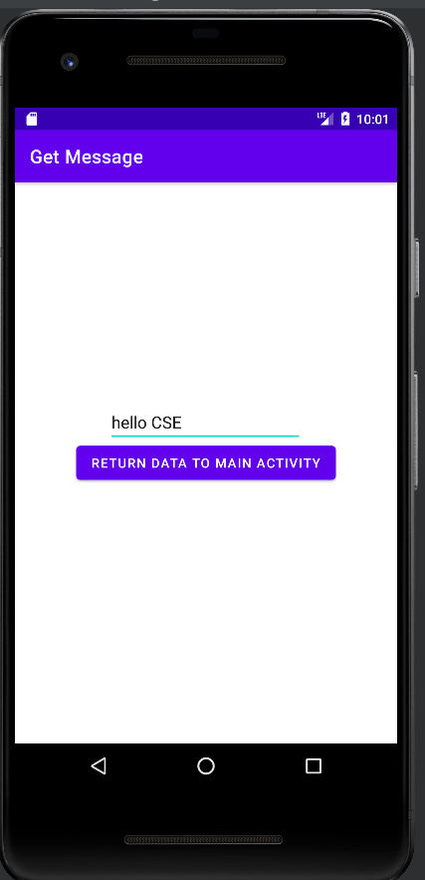
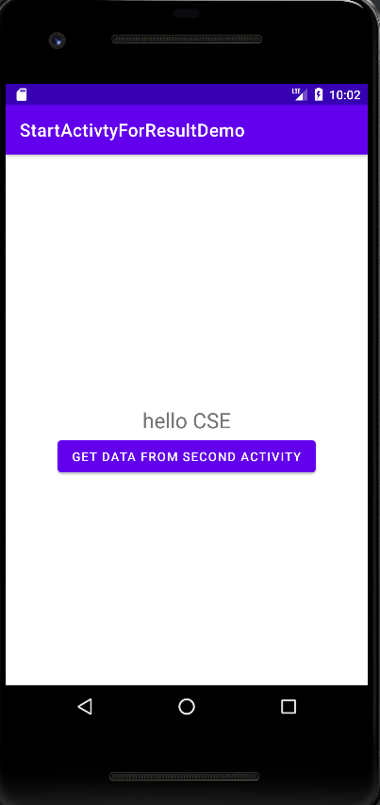
Output:

Slide 30
Broadcast Receivers
Broadcast Receivers simply respond to broadcast messages from other applications or from the system itself.
These messages are sometime called events or intents.
For example, applications can also initiate broadcasts to let other applications know that some data has been downloaded to the device and is available for them to use, so this is broadcast receiver who will intercept this communication and will initiate appropriate action.
There are following two important steps to make BroadcastReceiver works for the system broadcasted intents −
1.Creating the Broadcast Receiver.
2.Registering Broadcast Receiver

Slide 31
Creating the Broadcast Receiver:
public class MyReceiver extends BroadcastReceiver {
@Override
public void onReceive(Context context, Intent intent) {
Toast.makeText(context, "Intent Detected.", Toast.LENGTH_LONG).show();
}
}

Slide 32
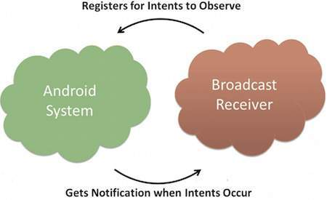
Registering Broadcast Receiver:
An application listens for specific broadcast intents by registering a broadcast receiver in AndroidManifest.xml file.
Consider we are going to register MyReceiver for system generated event ACTION_BOOT_COMPLETED which is fired by the system once the Android system has completed the boot process.

Slide 33
In Android manifest file we need to include receiver tag.
<application android:icon="@drawable/ic_launcher" android:label="@string/app_name" android:theme="@style/AppTheme" >
<receiver android:name="MyReceiver">
<intent-filter>
<action android:name="android.intent.action.BOOT_COMPLETED">
</action>
</intent-filter>
</receiver>
</application>

Slide 34
There are several system generated events defined as final static fields in the Intent class. The following table lists a few important system events.
Sr.No | Event Constant & Description
1 | android.intent.action.BATTERY_CHANGED Sticky broadcast containing the charging state, level, and other information about the battery.
2 | android.intent.action.BATTERY_LOW Indicates low battery condition on the device.
3 | android.intent.action.BATTERY_OKAY Indicates the battery is now okay after being low.
4 | android.intent.action.BOOT_COMPLETED This is broadcast once, after the system has finished booting.

Slide 35
5 | android.intent.action.BUG_REPORT Show activity for reporting a bug.
6 | android.intent.action.CALL Perform a call to someone specified by the data.
7 | android.intent.action.CALL_BUTTON The user pressed the "call" button to go to the dialer or other appropriate UI for placing a call.
8 | android.intent.action.DATE_CHANGED The date has changed.
9 | android.intent.action.REBOOT Have the device reboot.

Slide 36
Broadcasting Custom Intents:
If you want your application itself should generate and send custom intents then you will have to create and send those intents by using the sendBroadcast() method inside your activity class.
public void broadcastIntent(View view) {
Intent intent = new Intent(); intent.setAction("com.example.CUSTOM_INTENT"); sendBroadcast(intent);
}

Slide 37
Register the intent in androidmanifest.xml file.
<application android:icon="@drawable/ic_launcher" android:label="@string/app_name" android:theme="@style/AppTheme" >
<receiver android:name="MyReceiver">
<intent-filter>
<action android:name="com.example.CUSTOM_INTENT">
</action>
</intent-filter>
</receiver>
</application>

Slide 38
Services
Services in Android are a special component that facilitates an application to run in the background in order to perform long-running operation tasks.
The prime aim of a service is to ensure that the application remains active in the background so that the user can operate multiple applications at the same time.
A user-interface is not desirable for android services as it is designed to operate long-running processes without any user intervention. A service can run continuously in the background even if the application is closed or the user switches to another application.
Example:
Playing music in the background is a very common example of services in android. From the time when a user starts the service, music play continuously in the background even if the user switches to another application. The user has to stop the service explicitly in order to pause the music.

Slide 39
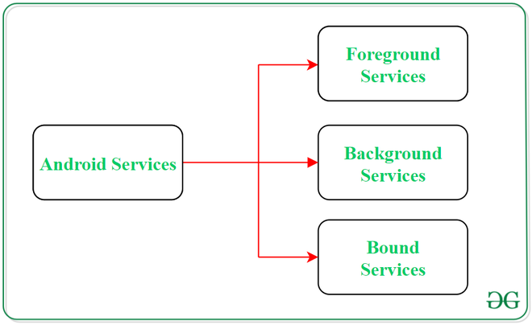

Slide 40
1. Foreground Services:
Services that notify the user about its on-going operations are termed as Foreground Services. Users can interact with the service by the notifications provided about the on-going task. Such as in downloading a file, the user can keep track of the progress in downloading and can also pause and resume the process.
2. Background Services:
Background services do not require any user intervention. These services do not notify the user about on-going background tasks and users also cannot access them. The process like schedule syncing of data or storing of data fall under this service.
3. Bound Services:
This type of android service allows the components of the application like activity to bound themselves with it. Bound services perform their task as long as any application component is bound to it. More than one component is allowed to bind themselves with a service at a time. In order to bind an application component with a service bindService() method is used.

Slide 41
The Life Cycle of Android Services
In android, services have 2 possible paths to complete its life cycle namely Started and Bounded.
1. Started Service (Unbounded Service):
By following this path, a service will initiate when an application component calls the startService() method. Once initiated, the service can run continuously in the background even if the component is destroyed which was responsible for the start of the service. Two option are available to stop the execution of service:
By calling stopService() method,
The service can stop itself by using stopSelf() method.
2. Bounded Service:
It can be treated as a server in a client-server interface. By following this path, android application components can send requests to the service and can fetch results. A service is termed as bounded when an application component binds itself with a service by calling bindService() method. To stop the execution of this service, all the components must unbind themselves from the service by using unbindService() method.

Slide 42
